Slide 1



AI & Deep Learning
Credit Card Default Issue
Subham Sarangi

Slide 2


Business Understanding
Credit Card Default Issue
A single missed credit card payment does not constitute a default. A payment default happens when you fail to pay the Minimum Amount Due on your credit cardfor several months in a row. The card issuer usually sends the default notification after 6 consecutive missed payments. The bank, however, has the last say.
Problem Statement
A Taiwanese credit card provider aims to increase its capacity for forecasting consumer default and determine the key variables that influence this risk. This would enable the issuer to select the recipients of credit cards and the credit limits they will offer. In addition, it helps issuers or businesses to better understand their current and potential customers, guiding future strategies and plans for offering customized lending products to their customers. This can be predicted based on the customer's payment behaviour and default status over the last six months.

Slide 3
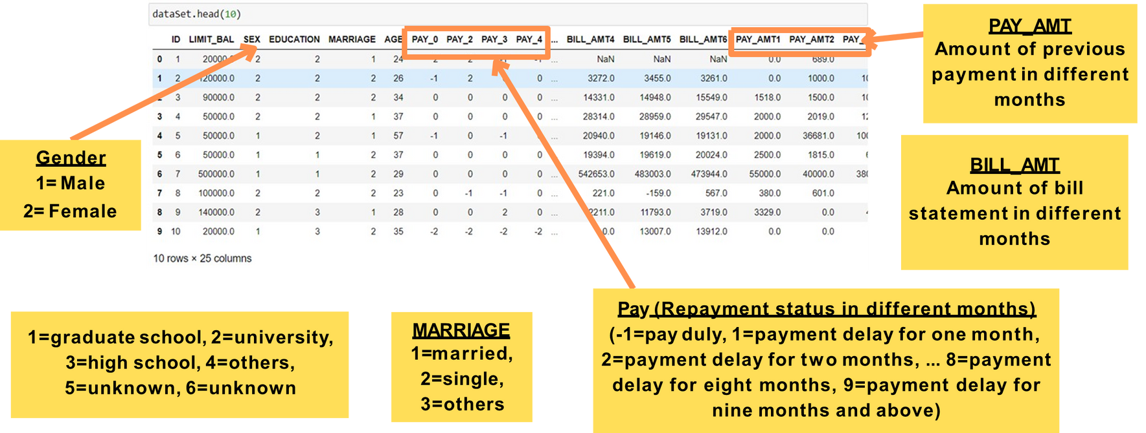
Data Understanding
We are preparing to understand the problems faced by the banks, when a credit card is being issued to customers to avoid the problem of default to understand, whether the credit card customer will make payment default in the next month or not based on number of features:

Slide 4
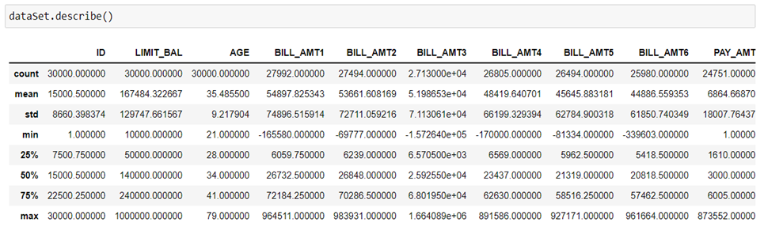
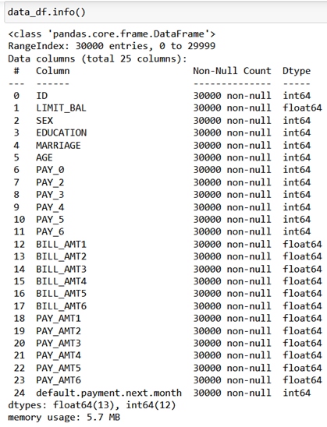
Exploratory Data Understanding
Descriptive Statistics
We can infer that our dataset has 25 columns and 3000 rows (as previously shown in the report). The information on the dataset reported below show that there are no missing features for any of the $30,000$ samples.
The dataset has 30000 rows and 25 columns
A total number of elements in the dataset:750000

Slide 5
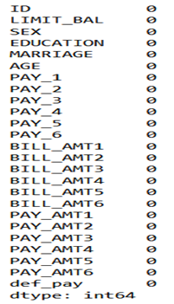
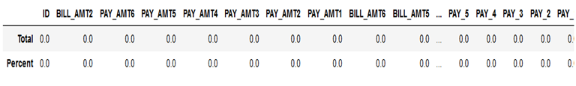
Null or Missing values in dataset
This returns the number of null values in each column. As we can see, There is no missing data in the entire dataset. Also, we determined what percentage of the null values are present in each column. There are columns that have 0% null values.

Slide 6
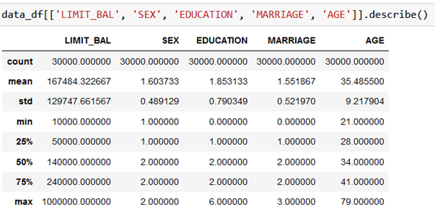
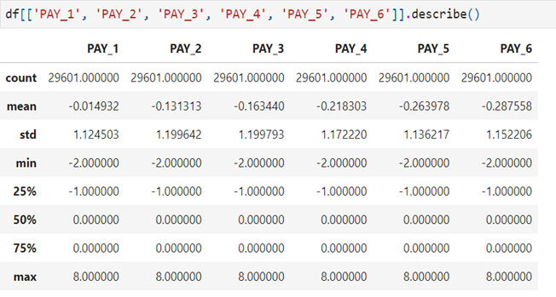
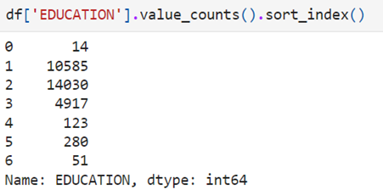
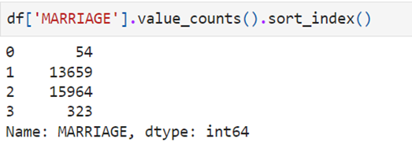
Data Preprocessing
Client Personal Information
Changing the incorrect attribute or removing the rows involved in the issue can fix errors in the dataset. We could be cautious and put the undocumented categories into another category, but since there aren't many anomalous entries (399, or 1.33% of total), we choose to remove the anomalies in the MARRIAGE column and combine the 0, 5, and 6 categories in EDUCATION into category 4, or "others" only.
History of Past Payments

Slide 7
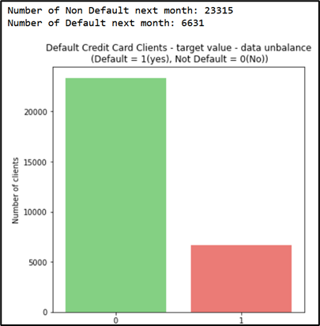
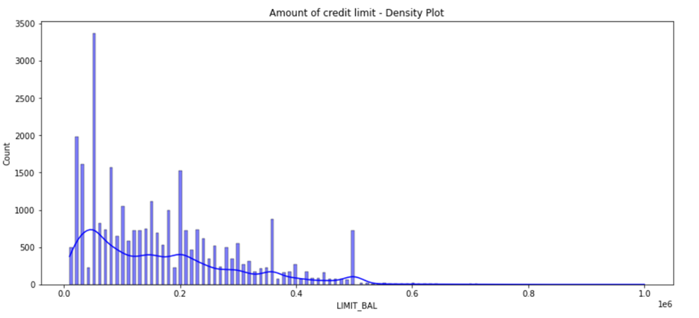
Data Exploration
Number of defaulters and non-defaulters in next month Interpretation
Credit card limit distribution across data
we found out that there are 23315 non-defaulters next month and 6631 defaulters next month, which is 3.5 times lower than the non-defaulters
we observe that dataset consists of skewed data of limiting balance. We have more number of clients having limiting balance between 0 to 200000 currency

Slide 8
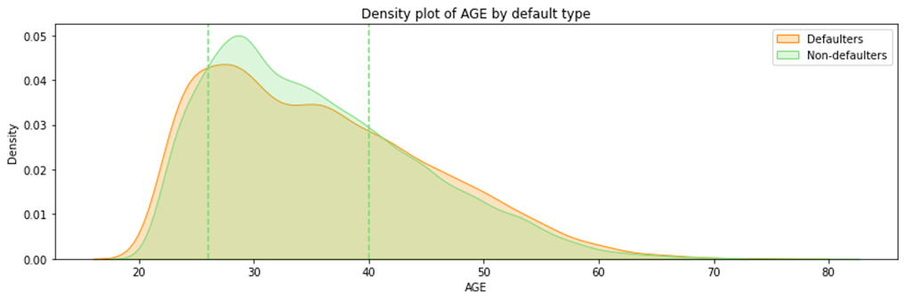
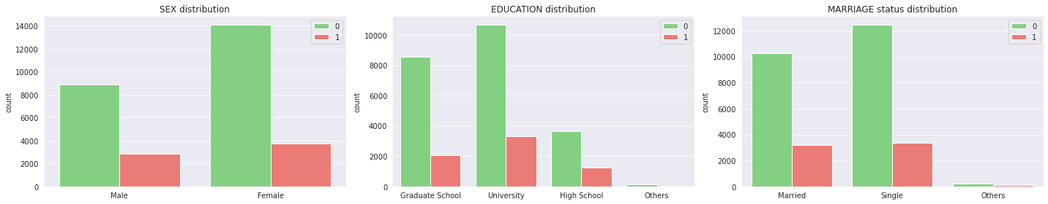
AGE Distribution by default type
The probability of non-default of age between approximately $25$ and $40$ is higher, which indicates that consumers in this age group are more capable of repaying credit card loans
Relation between Sex, Education and Marraige

Slide 9
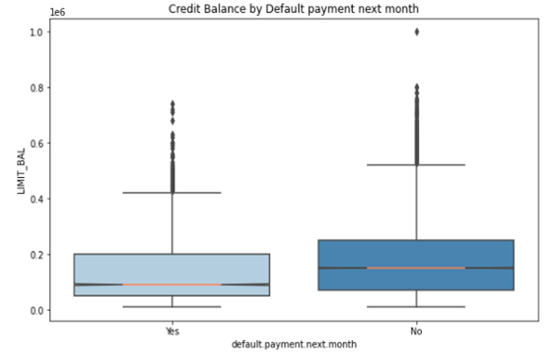
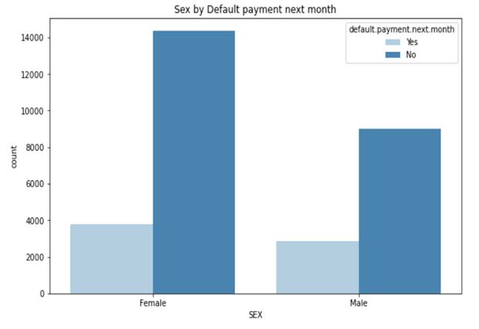
Relation: Limit or Credit Bal by Default Payment next month
Relation: Sex by Default payment next month
The median credit card limit balance of the customers who will default next month is less than the median credit card limit balance of the customers who will not default
The number of defaults for the next month is almost the same for men and women, however non-defaulter payments for the next month are highest for the women compared to men by 7000

Slide 10
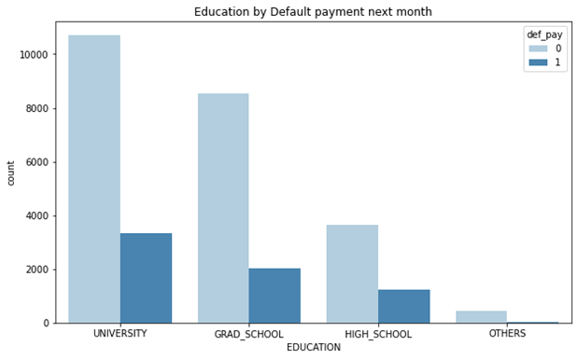
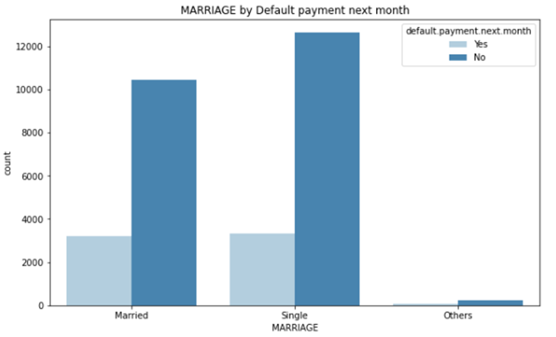
Relation: Education by Default payment next month
Relation: Marriage by Default payment next month
The qualification increases the non-defaulter list is increasing as well as the defaulter list, although defaulters are 1/3rd of the count compared to the non-defaulters
The number of defaulters in credit card payments is nearly the same for married credit card users as compared to the credit card users who are single

Slide 11
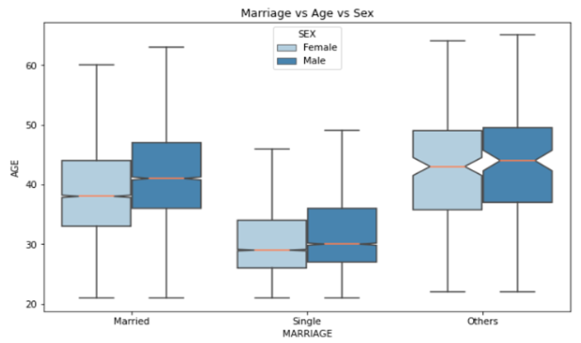
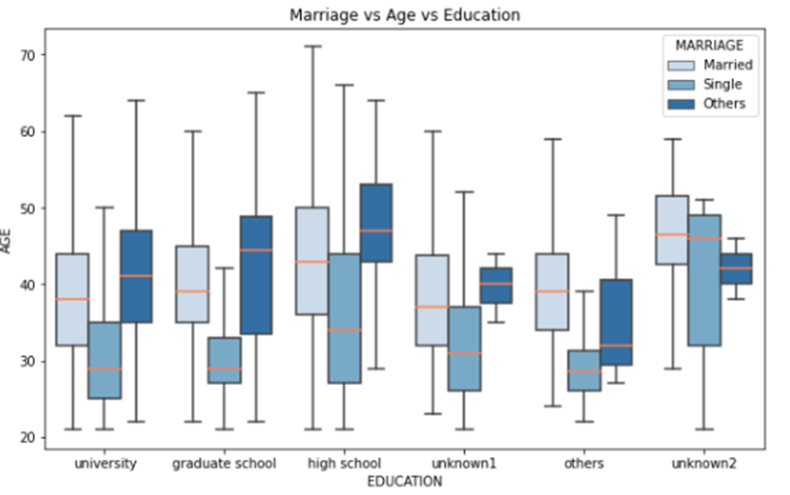
Relation: Marriage vs Sex vs Age
the mean age for both men and women is nearly the same in the case of singles and others but in the case of the Married category there is a notable difference in the mean with mean age of men being more than that of women
Relation: Marriage vs Age vs Education
The distribution of the people based on Qualification and Marriage, here we can say that 40 to 50 years age are in the major mean areas, the highest distribution of age was for high school followed by university and graduate school

Slide 12
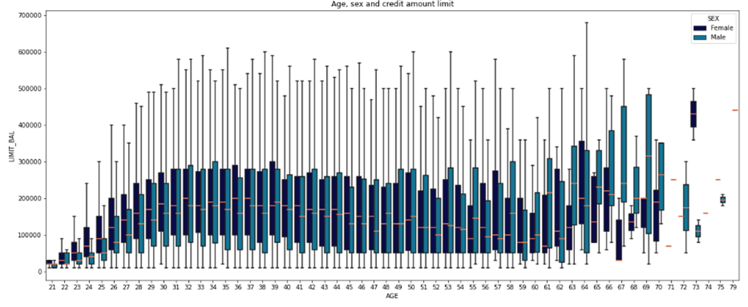
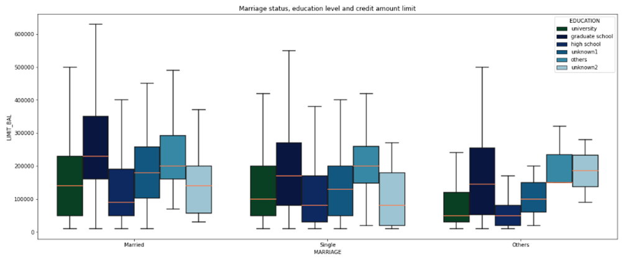
Relation: Age vs Sex vs Credit amount limit
The relationship between credit card limit balances with the respective individual ages shown by male and female, and the distribution across the credit card limit balances spread over the respective range for those ages.
Relation: Marriage status vs Education vs Credit limit
the averages for the different age groups for the limit balances do not coincide for the respective marital statuses. Also, the credit limit is highest for the married.

Slide 13
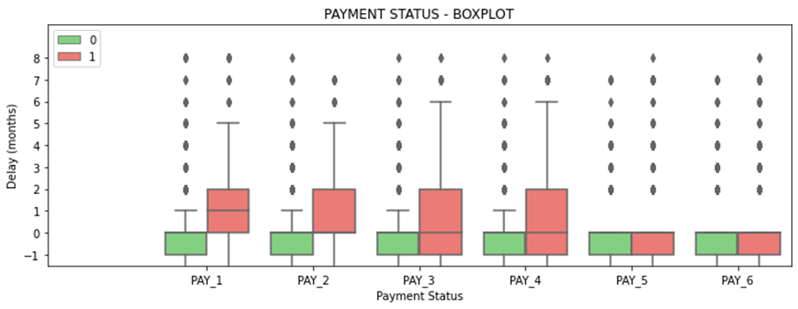
PAYMENT STATUS FEATURES (BY TARGET)
Clients who delay payment by one month or less have fewer credit card defaults. In particular, the repayment status in September, i.e., PAY_1, holds a greater discriminatory power than the repayment status in the other months

Slide 14
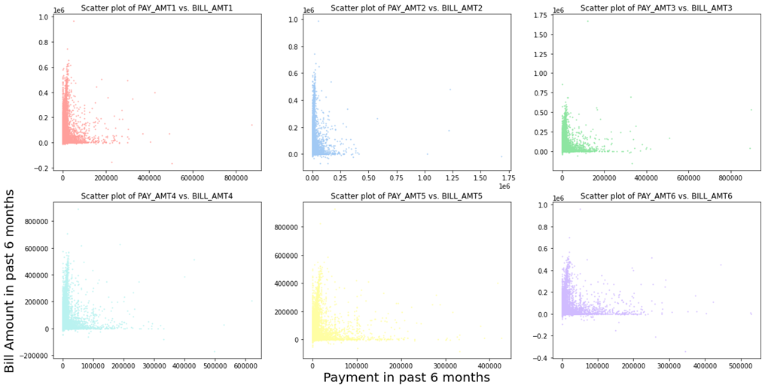
Past six months bill amount effect on the payment default next month or not:
There is higher proportion of clients for whom the bill amount is high but payment done against the same is very low. This we can infer since maximum number of datapoints are closely packed along the Y-axis near to 0 on X-axis.

Slide 15
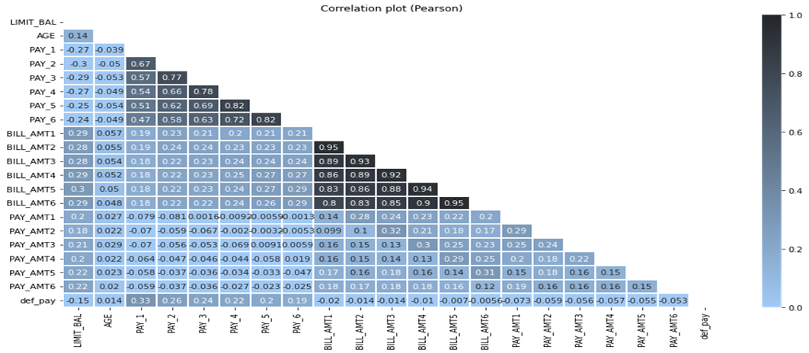
Correlation between variables
There is a strong positive correlation between the BILL_AMTn features, which may indicate a redundancy of information. We see that despite BILL_AMTX variables having high correlation, it would be a mistake to just drop all of them because they are important for the explanation of dependent variables.

Slide 16
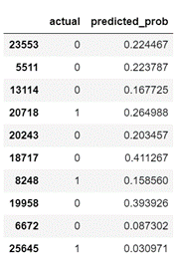
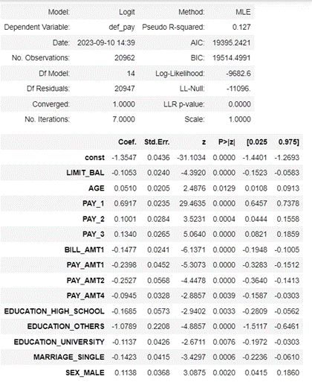
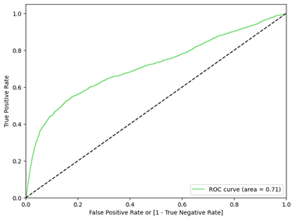
Data Modelling
Logistic Regression (Baseline Model)
Logistic Regression predicts event log odds using independent predictor variable
Rebuilding the model with only the significant variables
Extracting Predicted Probabilities
Measuring performance via the RoC Curve:
The AUC achieved here = 0.713

Slide 17
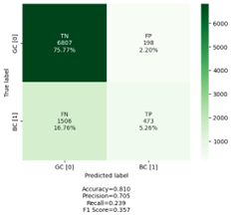
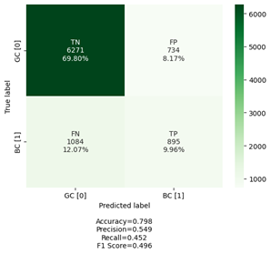
Measuring Performance of the Confusion Matrix
Accuracy = (TP + TN) / (TP + TN + FP + FN) - Proportion of objects rightly classified
Recall or Sensitivity = TP / (TP + FN) - Proportion of positives rightly classified
Specificity = TN/(TN + FP) - Proportion of negatives rightly classified
Precision = TP/(TP + FP) - Proportion of positives among all those classified a positives
F-Score : 2*Recall*Precision / (Recall + Precision) - Harmonic mean of precision and recall
Classifying on default threshold 0.5 and building the Confusion Matrix. The accuracy at threshold 0.5 = 0.810
After rebuilding with better threshold, accuracy is 0.798

Slide 18
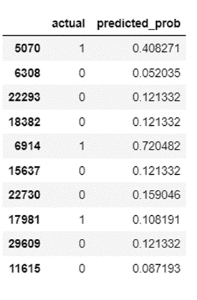
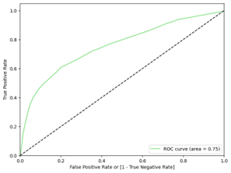

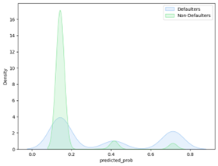
Decision Tree Classifier
Building the tree using Gini Criteria and extracting probabilities - Classifier performance = 75.4%
Interpretation: 7241 were correct predictions and 1743 were incorrect. Accuracy is 80.6%

Slide 19
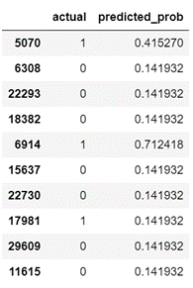
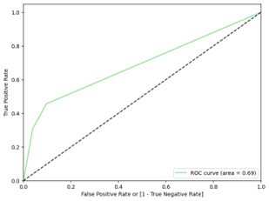

GINI impurity of node 1 = 0.276
Entropy of Node 1 = 0.65
Extracting Probabilities and measuring Classifier performance, Plotting Distributions and Identifying Optimal Probability
The Classifier performance is found to be 0.69

Slide 20
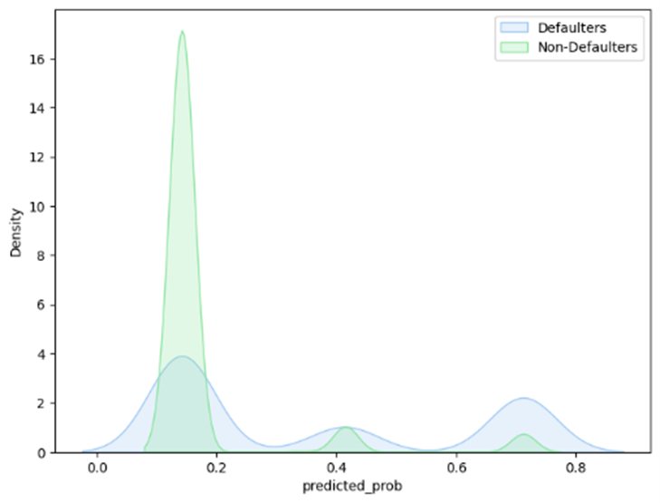
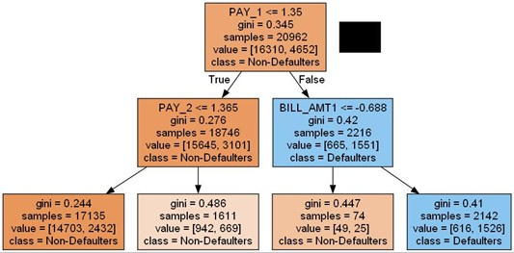
Decision Tree using Entropy Criteria
Plotting Distributions and Identifying Optimal Probability
The threshold value is obtained by intersecting the Yes and No plots and is approximately 0.18.
Therefore, probability exceeding 0.18 will be considered to be of class 1, and those below 0.18 will be considered to be of class 0.

Slide 21
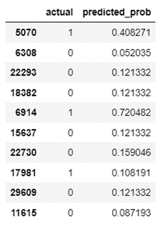
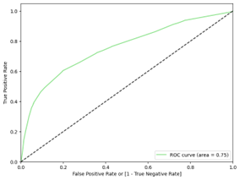

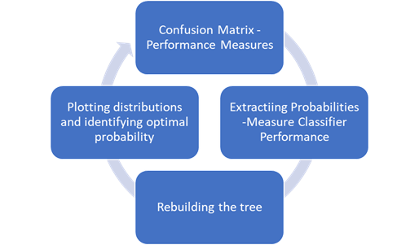
Finding optimal criteria and max depth, rebuilding the tree with entropy criteria and max depth 6
Interpretation: 7241 were correct predictions and 1743 were incorrect. Accuracy is 80.6%

Slide 22
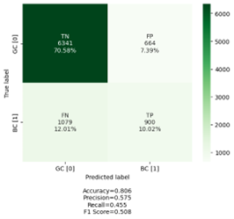
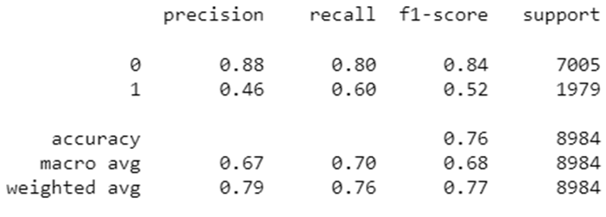
Final Confusion Matrix - Classifier Interpretations
Precision: 58% for defaulting clients, 85% for non-defaulting clients.
Recall: 45% for defaulting clients, 91% for non-defaulting clients.
F-Score indicates the model does fairly well in predicting defaults.
Accuracy stands at 76%.
Interpretation: 7241 were correct predictions and 1743 were incorrect

Slide 23
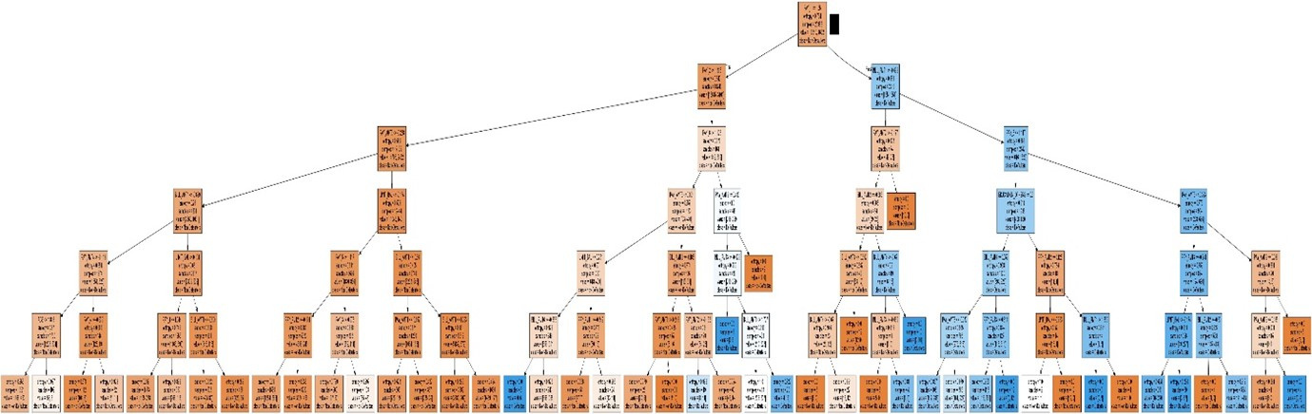
The threshold value is obtained by intersecting the Yes and No plots and is approximately 0.22.
Therefore, probability exceeding 0.22 will be considered to be of class 1, and those below 0.18 will be considered to be of class 0.
· Visualizing Decision Tree with depth=6

Slide 24
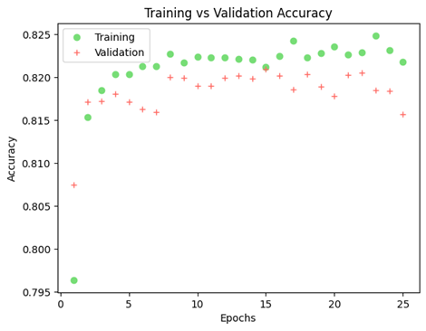
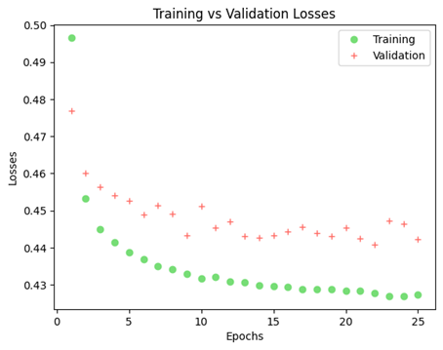
Dense Neural Network
Model: Dense Neural Network (Keras)
Task: Binary classification
Data: 70/30 split, standardized
Architecture: 16-8-1 neurons, sigmoid output
Compilation: Binary cross-entropy loss, RMSprop optimizer
Training: 25 epochs, batch size 32
Evaluation: Accuracy and loss monitored (plots available)
Next Steps: Hyperparameter tuning

Slide 25

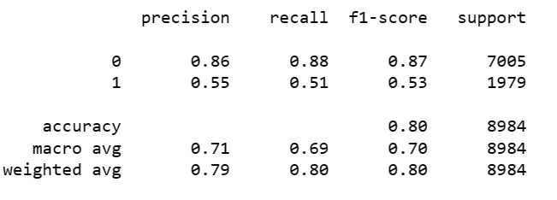
From all 7005 NO's, 6189 NO's are correctly predicted, and 816 NO's are predicted as YES.
From all 1979 YES, 1001 YES are correctly predicted, and 978 YES are predicted as NO.
The confusion matrix shows a solid performance for model accuracy (0.8) but moderate scores for precision (0.55) and recall (0.5).
This shows that while the model in general can identify labels well, the rate of false positives over totality of predicted positives is quite high. That can be a significant model shortcoming in the case of identifying defaulting customers.

Slide 26
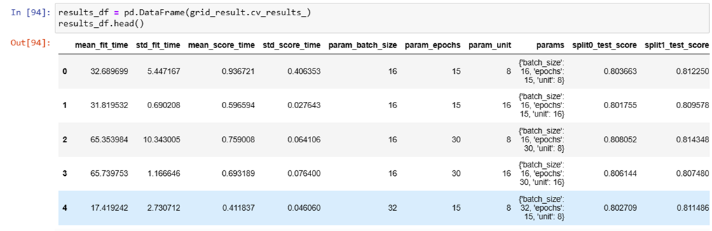
Hyperparameter Tuning Methods
Standardization
Dividing Data: into training and testing sets (70% and 30%, respectively).
Hyperparameter Tuning - Grid Search
Grid Search exhaustively explores hyperparameter combinations, assessing training/scoring times, hyperparameter values, cross-validation test scores, and ranks based on mean_test_score, making it time-consuming and resource-intensive.
Interpretation: The Grid Search identified a combination of batch_size=16, epochs=30, and unit=8 as the one offering the highest average test score of 0.816764

Slide 27
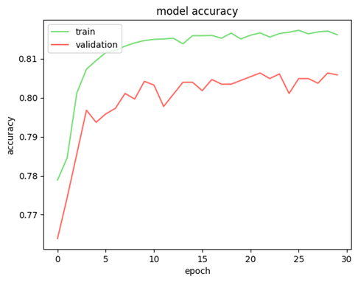
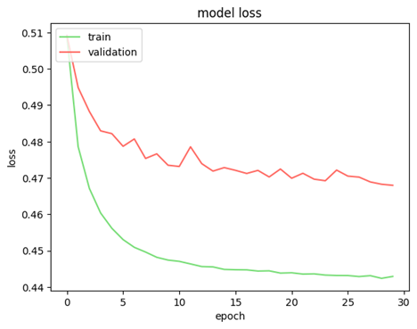
Model Building with Identified Hyperparameters
Steady improvement in training and validation accuracy for initial 10-15 epochs.
Plateaued performance beyond 15 epochs, indicating peak performance.
Final training accuracy: 81.61%, validation accuracy peak: 80.63%, suggesting slight overfitting.
Convergence observed with consistent decrease in training and validation loss.
Potential for early stopping after around 20 epochs due to minor fluctuations in validation accuracy.
Overall assesment:The model exhibits a reasonable level of accuracy, suggesting effective learning; however, slight overfitting signals may be mitigated through regularization or early stopping, with potential performance enhancement through adjustments to model architecture and hyperparameter tuning.

Slide 28
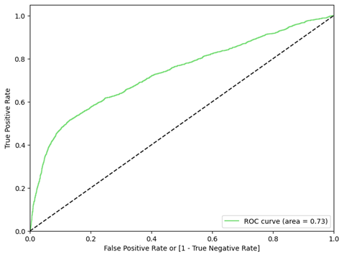
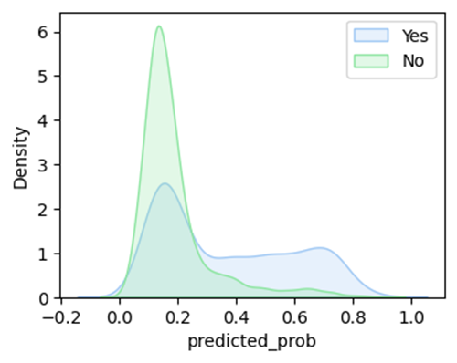

Model Validation: The AUC score of 0.7333 indicates moderate performance
Confusion Matrix:
Kernel density plots depict predicted probability distributions for 'Yes' and 'No' classes, while the confusion matrix indicates:
High accuracy (84%) for class 0 with 84% recall and precision.
Lower accuracy (82%) for class 1, marked by 37% recall and 65% precision.
Overall accuracy is 82%, favoring the larger class (0).

Slide 29

Hyperparameter Tuning - Random Search
Randomized Search CV, employing early stopping, explores various hyperparameter combinations using 4-fold cross-validation. The top-performing configuration, unit=12, epochs=45, batch_size=32, achieved the highest average test score of 0.8158, indicating sensitivity to parameter choices. The best overall score is 0.8191 with hyperparameters {'unit': 8, 'epochs': 30, 'batch_size': 8}. Iterating through combinations, the loop prints scores and corresponding hyperparameters.

Slide 30


Model Building with Identified Hyperparameters
Initial effective learning plateaued after 15-20 epochs.
Final accuracies: Training 82.23%, validation 80.80%.
Slight overfitting indicated by consistently higher training accuracy.
Convergence observed in decreasing training and validation loss.
Potential for early stopping around 20 epochs to prevent overfitting and save time.

Slide 31



AUC score of 0.7547 indicates moderate performance, signifying the model's reasonable ability to distinguish between positive and negative cases.
Performance Measure: High accuracy for Class 0 (precision 0.84, recall 0.95), lower accuracy for Class 1 (precision 0.68, recall 0.36). Overall accuracy is 0.82, and macro/weighted averages suggest moderate performance across both classes
Interpretation: Model excels with majority class (0) but struggles with class 1, as shown by lower recall and precision. AUC score supports moderate class discrimination. Overall accuracy may be acceptable, but class performance disparity is crucial to consider in context.

Slide 32

Hyperparameter Tuning - Bayesian Optimization
Bayesian optimization tunes model architecture with units (8-64) and activation (sigmoid or relu) for highest validation accuracy. Executed for 5 trials, the best accuracy achieved is 0.8247 in 6 minutes 58 seconds, with the 5th trial scoring 0.8163.
Interpretation: Bayesian optimization, in 5 trials, found the best hyperparameter configuration with an accuracy of 0.8247 on the validation set, indicating a successful identification of a promising combination for the model.

Slide 33


Model Building with Identified Hyperparameters
Learning and Convergence: Clear patterns observed in both training and validation accuracy and loss over 20 epochs.
Final Accuracies: Training accuracy of 82.10% and validation accuracy of 80.94% indicate reasonable generalization.
Minimal Overfitting: Slight gap between training and validation accuracy suggests minimal overfitting.
Dropout Effectiveness: Inclusion of a 5% dropout layer appears effective in mitigating overfitting, evident in the close alignment of training and validation accuracy curves.

Slide 34



AUC score improved slightly from 0.7547 to 0.7595, indicating a marginal increase in the model's discrimination ability between positive and negative cases.
Class 0 performance remains high, while Class 1 recall is still lower at 33%.
Overall accuracy stays around 82%, similar to the previous analysis.
Precision and F1-score for Class 1 slightly lower, and the recall gap between classes widened.
Interpretation: Bayesian optimization led to a minor AUC improvement, but Class 1 performance regressed, indicating suboptimal hyperparameters for addressing class imbalance or specific characteristics of Class 1 samples.

Slide 35


Hyperparameter Tuning - Hyperband Optimisation
Hyperband tuner maximizes accuracy with parameters like max_epochs (300), hyperband_iterations, and a reduction factor (10x per round). Early stopping prevents overfitting, with the 16th trial achieving 0.7857 accuracy, and the current best is 0.8125. Top hyperparameters are 56 neurons in the first layer with relu activation.
Learning and Convergence: Clear patterns observed in both training and validation accuracy and loss over 20 epochs.
Final Accuracies: Training accuracy 82.22%, validation accuracy 80.11%, indicating moderate generalization.
Overfitting: Slightly larger gap between training and validation accuracy suggests potential overfitting.
Dropout Effectiveness: 5% dropout mitigated overfitting, but exploring higher dropout rates or additional regularization techniques is worth considering.

Slide 36



Overall Accuracy: 81%, consistent with previous analyses.
Class 0: High precision (0.82) and recall (0.97).
Class 1: Lower precision (0.71) and recall (0.28).
AUC Score: Slightly decreased to 0.7572, suggesting a marginal drop in class discrimination ability
Confusion matrix confirms class imbalance and difficulty in identifying true positives; kernel density plots reveal overlap in predicted probability distributions, emphasizing the challenge of distinguishing both classes.
Interpretation:
Hyperband identified a configuration with similar overall accuracy, but failed to improve performance on the minority class (1), evident in low recall. The overlap in predicted probability distributions and the slight decrease in AUC and F1-scores suggest suboptimal hyperparameters for addressing class imbalance or specific characteristics of class 1 samples.

Slide 37
Conclusion
Predictive Modeling for Credit Card Defaults:
Problem: Predicting client defaults to improve risk management and customer satisfaction.
Models: Promising results with Logistic Regression, Decision Trees, and DNNs.
Key Metrics: Prioritize recall (avoiding missed defaults) along with accuracy.
Key Variables:
Primary: Income, credit history, debt, utilization rate, and financial indicators.
Boosting Power: Credit scores, work history, and demographic data.
Model Selection:
Choice: Depends on goals, resources, and interpretability.
Strong Candidates: Logistic Regression (AUC, threshold adjustment) and Decision Trees (good performance, interpretability).
Exploration: Deep Neural Networks for potential improvements.

Slide 38
Neural Network Optimization:
Challenges: DNN sensitivity to hyperparameters, imbalanced data.
Tuning Methods: Grid Search, Random Search, Bayesian Optimization, and Hyperband Optimization.
Trade-offs: Optimizing for overall accuracy vs. identifying true defaults (recall).
Business Implications:
Reduced Losses: Informed decisions on approvals, credit limits, and risk assessments.
Personalized Offerings: Tailored credit options for specific customers.
Model Maintenance: Regular updates with fresh data due to changing behavior and economic conditions.

Slide 39
THANK
YOU!

